Slide 1


Customer retention
final project ironhack
rodrigo franco
daft aug22
Berlin

Slide 2
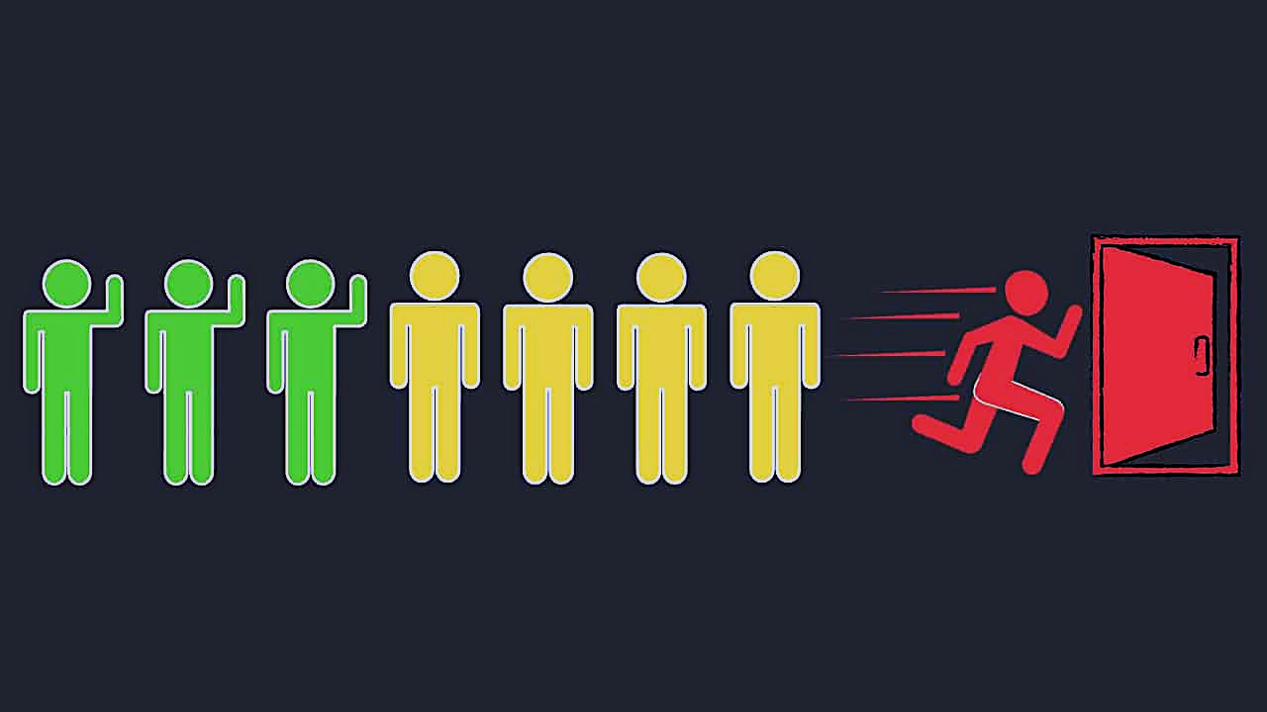
O b j e c t i v e
Our goal on this project is to predict the probability of customers churn on a company that focus on supplying gas and electricity for Small Medium Enterprises and residential customers. They want to have an effective decision to the declining customers "lately"
Our client propose to offer a 20% discount to the customers churned and we have to come to actionable insights from understanding the data better to decide whether is that a good idea or should we help to decide for other decisions
What Churn means in business?
In its broadest sense, is a measure of the number of individuals (Customer, Staff) or items (Financial Transactions) moving out of or into a collective group over a specific period of time

Slide 3
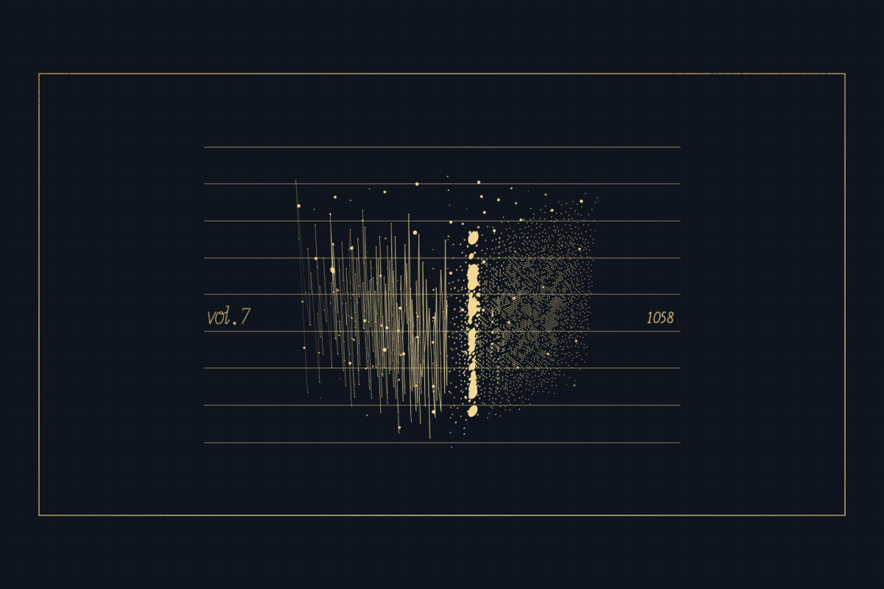
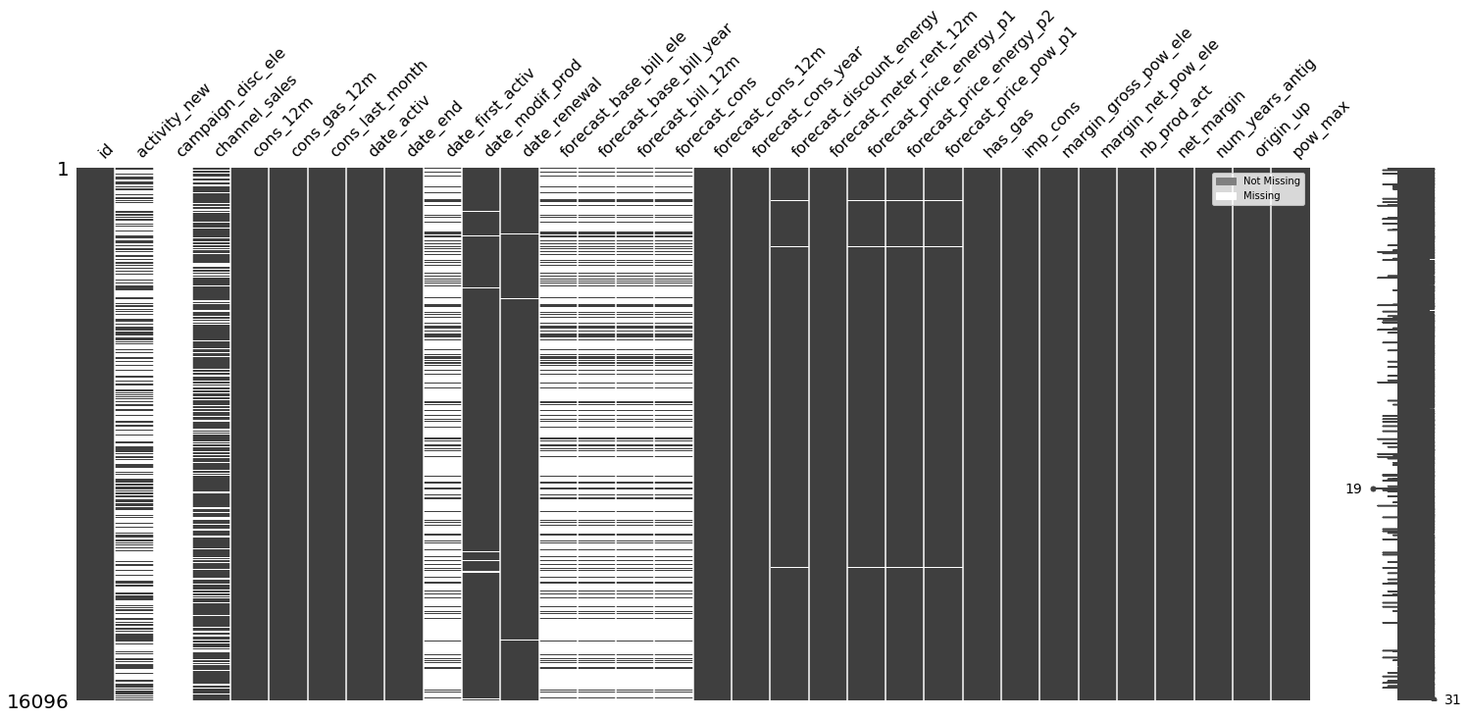
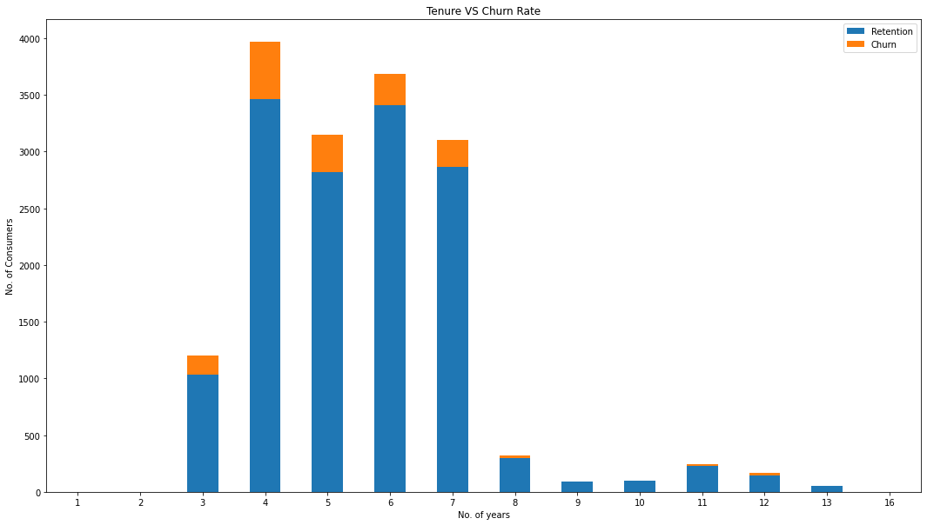
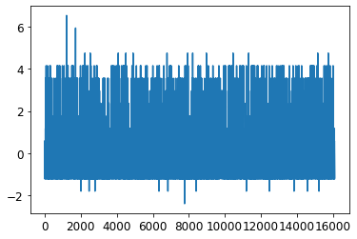
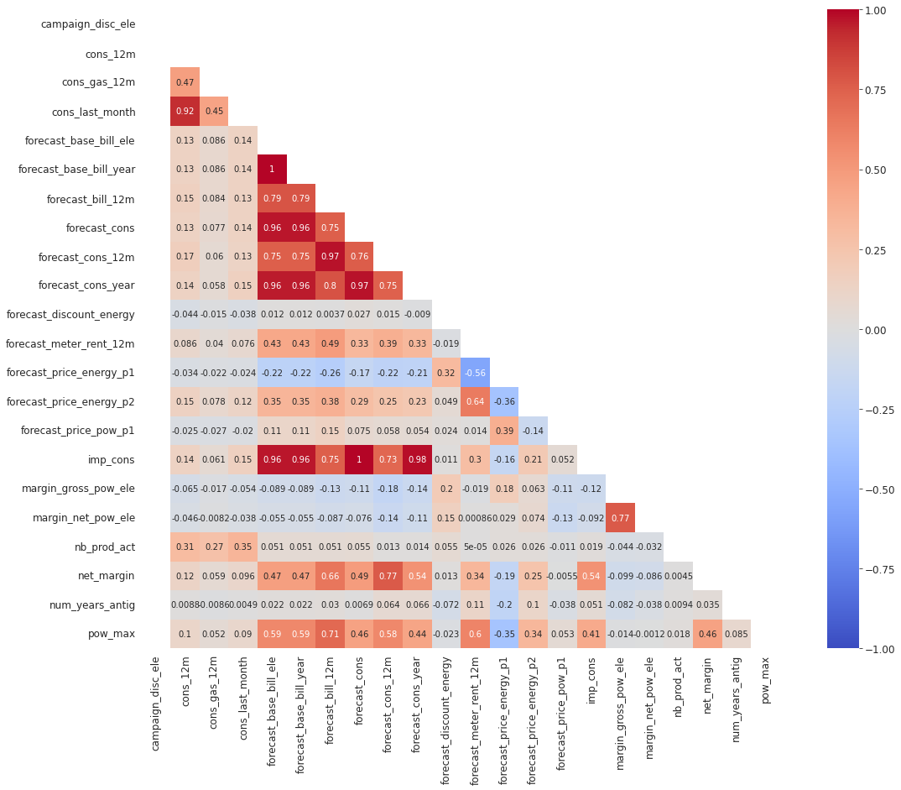
Preparing dataset
Duplicated rows
NaN values (fillna)
Neg. vaalues (abs)
1359 values missing
Date columns to datetime
3 DATASET
16096 r, 32 c
16096 r, 2 c
193002 r, 8 c

Slide 4
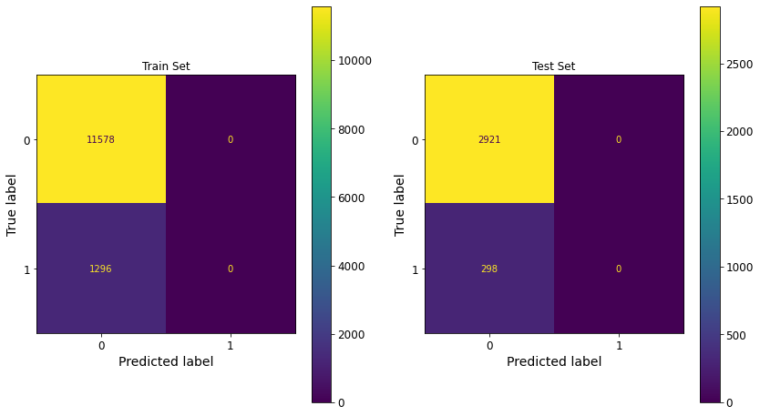
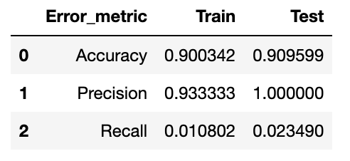
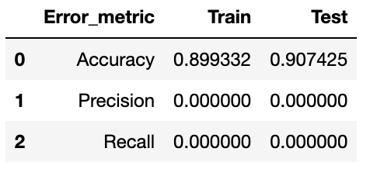
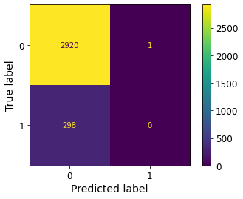

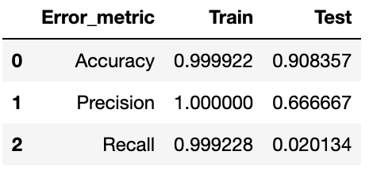
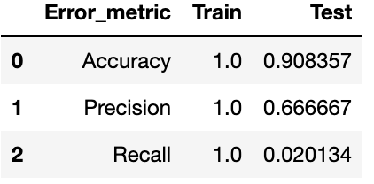
Algorithms (ml)
DECISION TREE
KN CLASSIFIER
LOGISTIC REGRESSION
RANDOM FORREST

Slide 5

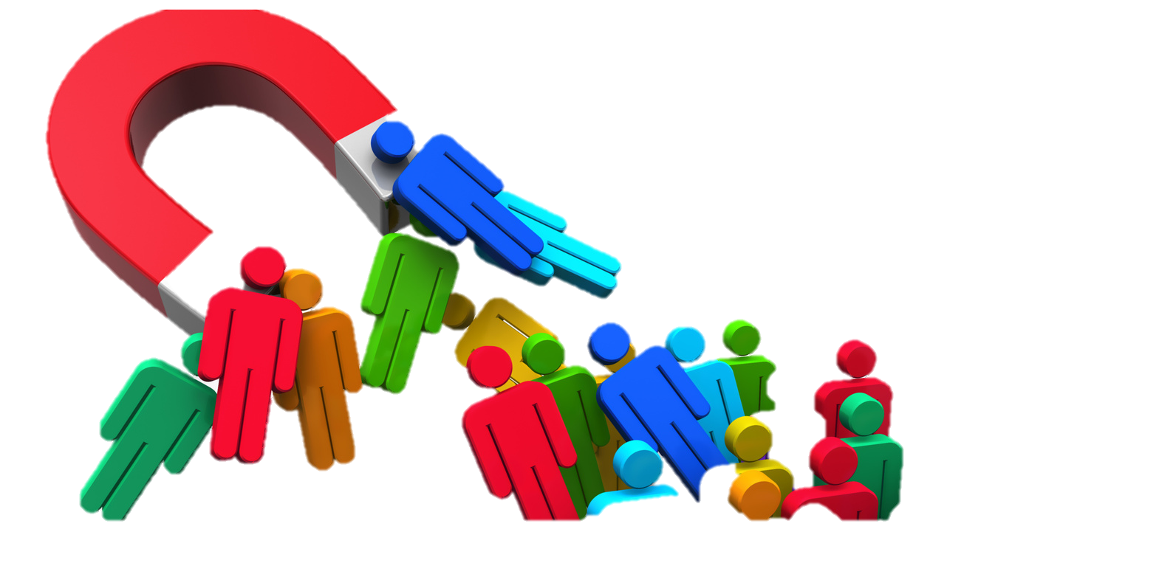
C O N C L U S I O N S
Base on the data
G E N E R A L
≈ 10% of customers are likely to churn in the first 3 months.
Very low churn for new customers or the very antique (3-7 years of tenure).
Average antiquity of customers who are likely to CHURN is 4 years
Average antiquity of customers who are likely to STAY is 5 years
Customers are more likely to churn in the 4th year than the 7th
An increase in customer retention is the same as decreasing costs
Repeat customers spend more in months 31-36 than in their first six months
Referred customers can spend more than the people that refer them
The probability of selling a new product to an existing customer is bigger than selling to a new one
Repeat customers refer more people to business through word-of-mouth

Slide 6
Muchas gracias
final project ironhack
rodrigo franco
daft aug22
Berlin

